Slide 1
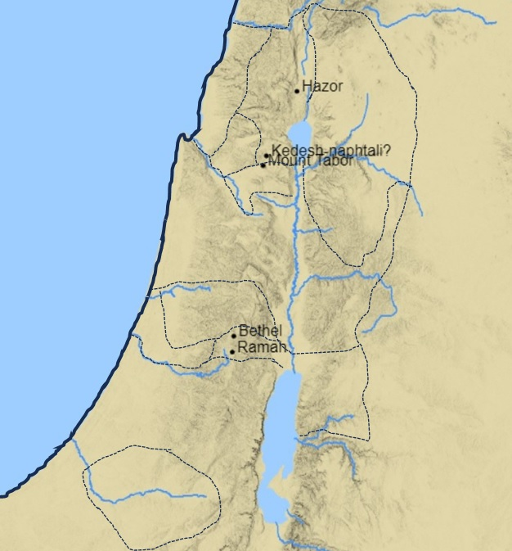
Locations in
Judges 4
Zebulun
Naphtali
River Kishon
Harosheth-hagoyim
Ephraim

Slide 2
Locations in
Judges 5
Zebulun
Naphtali
Asher
Manasseh
(half-tribe)
Issachar
Manasseh
(half-tribe)
Tribes which joined
Deborah and Barak
Tribes which did not join
Deborah and Barak
Ephraim
Gad
Dan
Reuben
Benjamin
Gilead

Slide 3
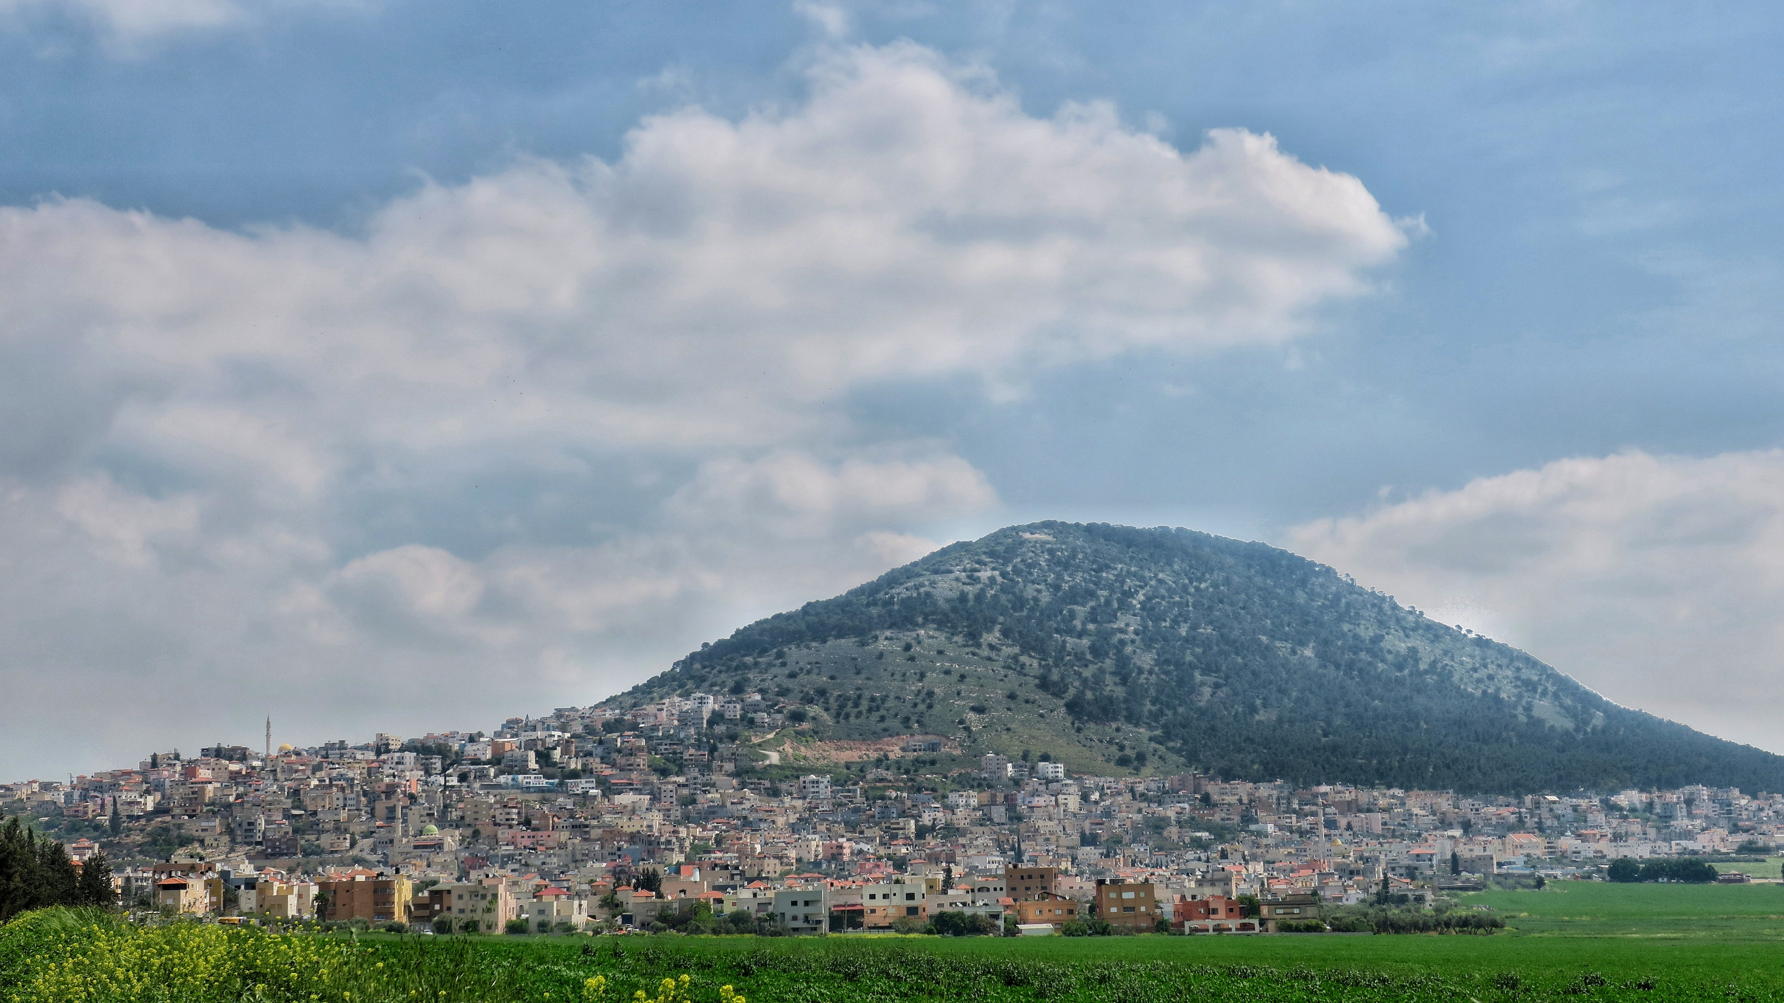
Mount Tabor
Photograph: Mount Tabor seen from the southwest, by Noamdahary
This file is licensed under the Creative Commons Attribution-Share Alike 4.0 International license.

